Slide 1
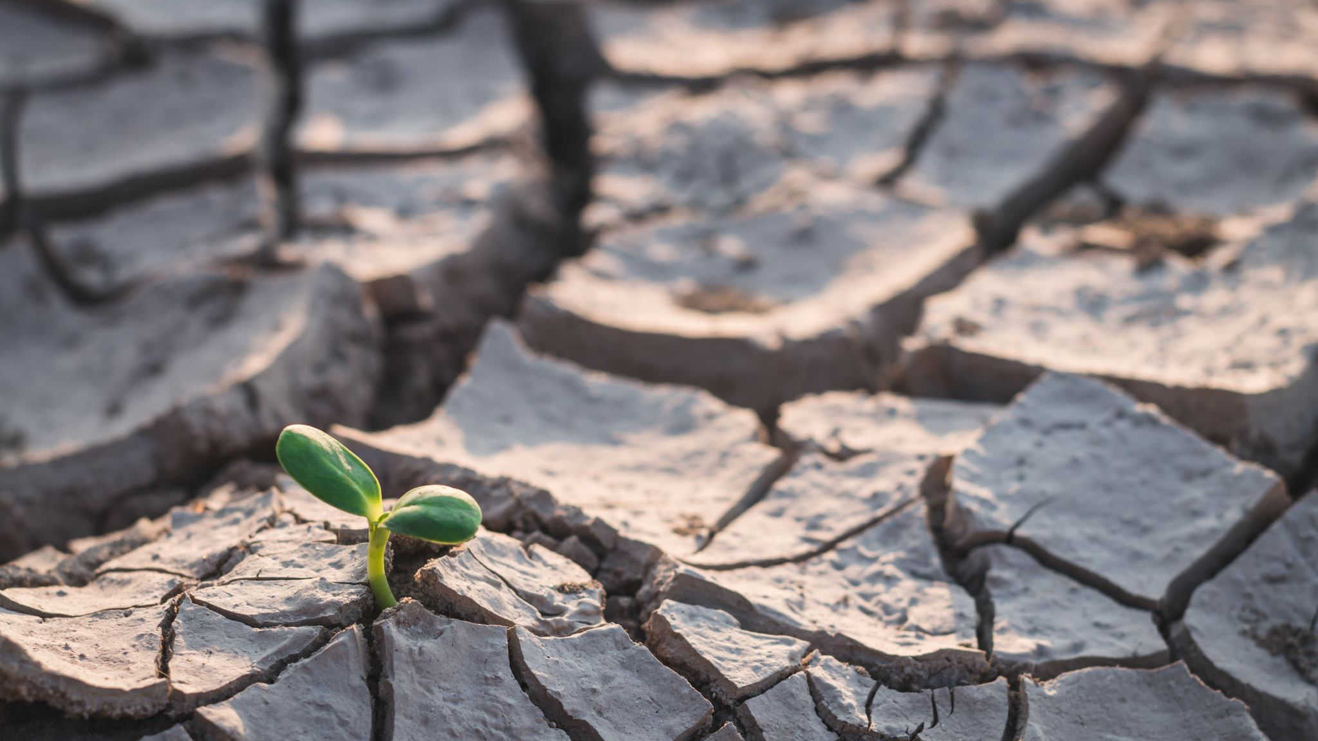
Climate Change Problem
By/ Shaimaa Hammad Youssef

Slide 2
TABLE OF CONTENTS​
Introduction​
Causes Of Climate Change​
Effects Of Climate Change​
Impacts On Human Society​
Solutions To Address Climate Change​
International Cooperation And Policy​
Conclusion​

Slide 3
I. Introduction
Definition of climate change
Brief overview of the problem

Slide 4
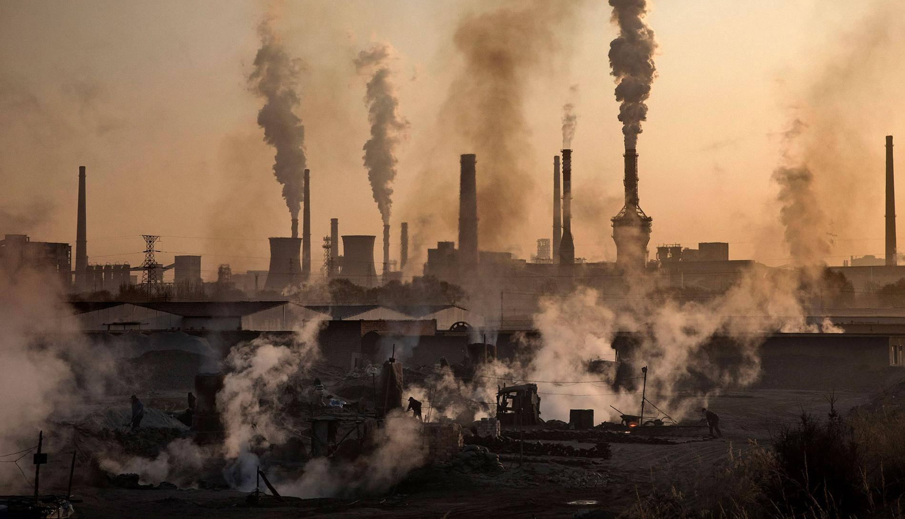
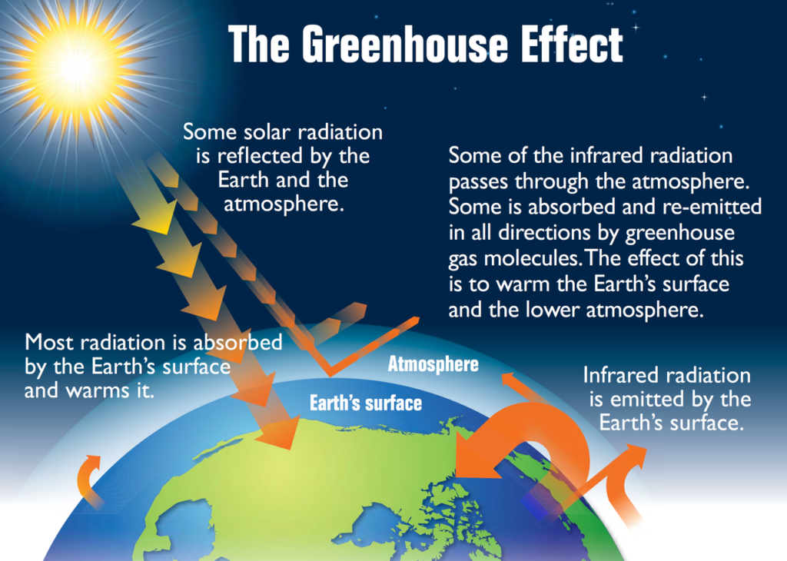
Overview of climate change problem
Long-term climate alteration, Caused by greenhouse gas accumulation, Temperature and precipitation changes, Primarily due to carbon dioxide emissions.

Slide 5
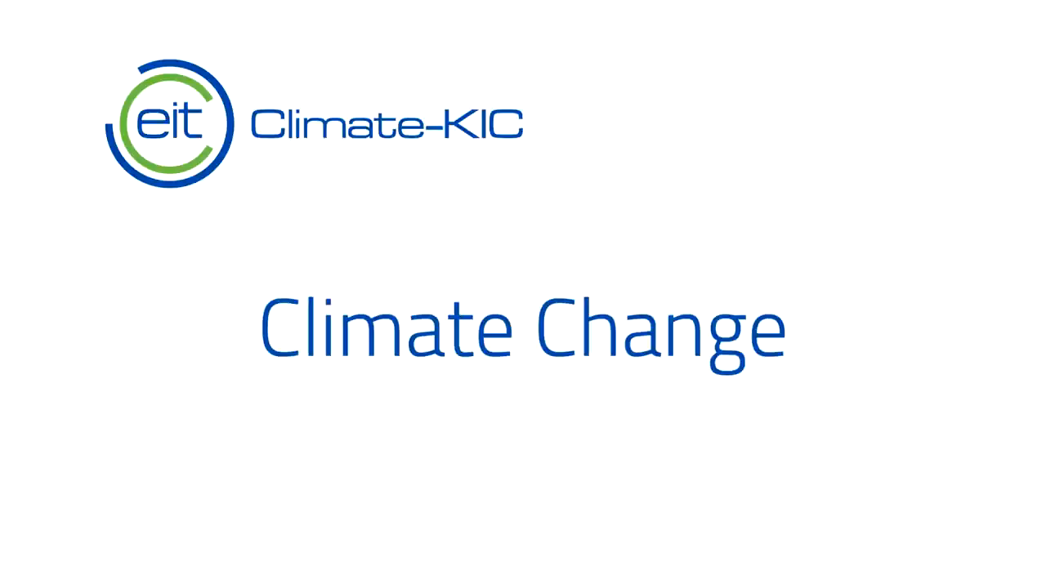

Slide 6
II. Causes of climate change
Greenhouse gas emissions
Deforestation
Industrial activities
Agricultural practices
Transportation

Slide 7
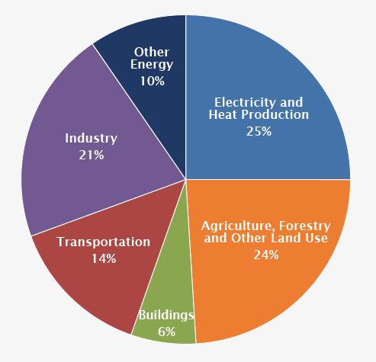
Greenhouse gas emissions:
These are gases that trap heat in the Earth's atmosphere, such as carbon dioxide, methane, and nitrous oxide. Human activities such as burning fossil fuels (coal, oil, and gas), industrial processes, and transportation are major sources of these emissions, which contribute to climate change.

Slide 8
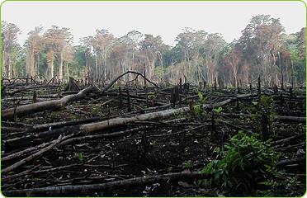
Deforestation:
Deforestation eliminates trees that absorb carbon dioxide and release oxygen, natural "carbon sinks" that regulate the Earth's climate, and releases stored carbon into the atmosphere.

Slide 9
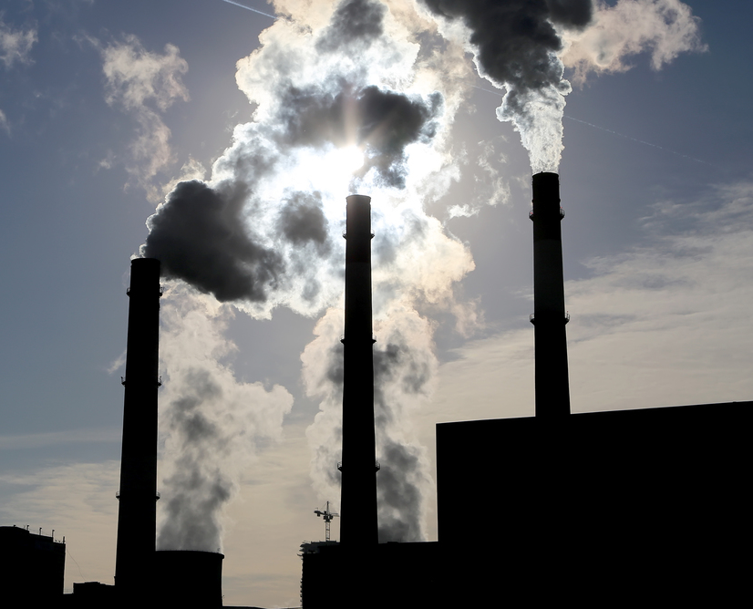
Industrial activities:
Industries such as manufacturing, mining, and construction produce greenhouse gas emissions through the burning of fossil fuels for energy, as well as the release of potent greenhouse gases such as hydrofluorocarbons (HFCs) used in refrigeration and air conditioning.

Slide 10
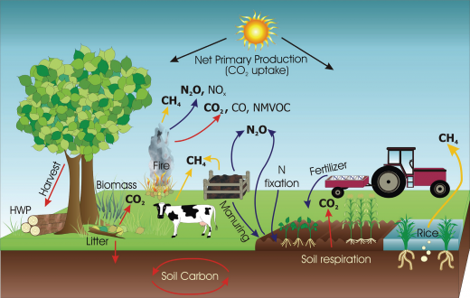
Agricultural practices:
Agriculture is another significant source of greenhouse gas emissions, particularly through livestock farming and the use of synthetic fertilizers.
Methane, a potent greenhouse gas, is produced by cattle during digestion and from manure storage.

Slide 11
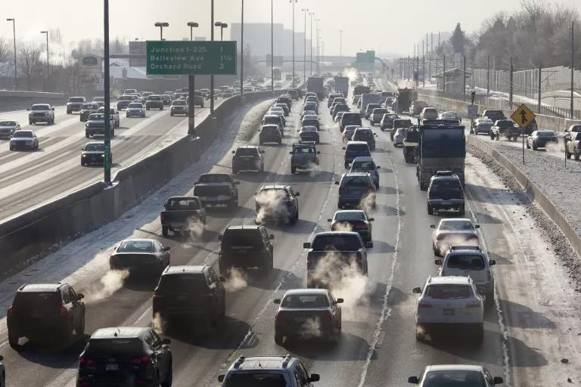
Transportation:
The transportation sector emits greenhouse gases by burning fossil fuels in cars, trucks, ships, and airplanes.
To reduce these emissions, efforts include promoting electric vehicles, public transportation, and reducing air travel.

Slide 12
III. Effects of climate change
Rising global temperatures
Changes in precipitation patterns
More frequent and severe weather events
Rising sea levels
Impacts on ecosystems
Impacts on human health

Slide 13
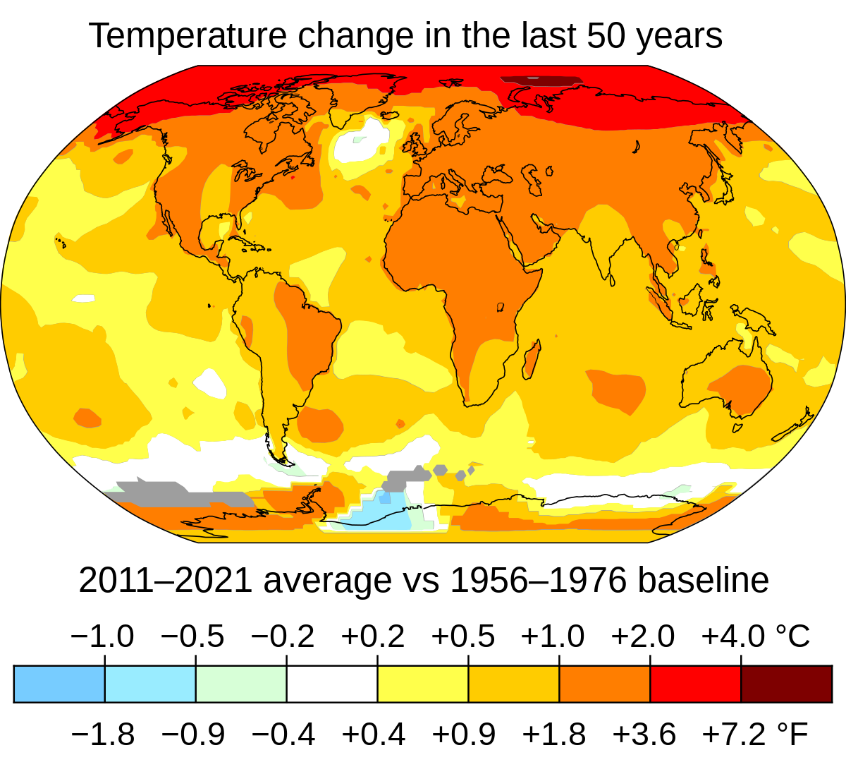
Rising global temperatures:
Climate change is causing global temperatures to rise at an unprecedented rate, leading to a range of impacts including melting of glaciers and sea ice, heatwaves, and more frequent and severe wildfires.

Slide 14
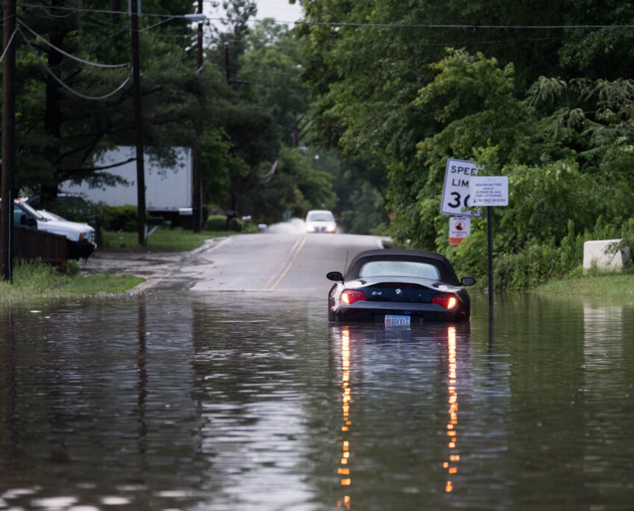
Changes in precipitation patterns:
Climate change is altering precipitation patterns, leading to more frequent and intense droughts, floods, and storms, as well as changes in the timing and amount of rainfall.
These changes can have significant impacts on agriculture, water resources, and ecosystems.

Slide 15
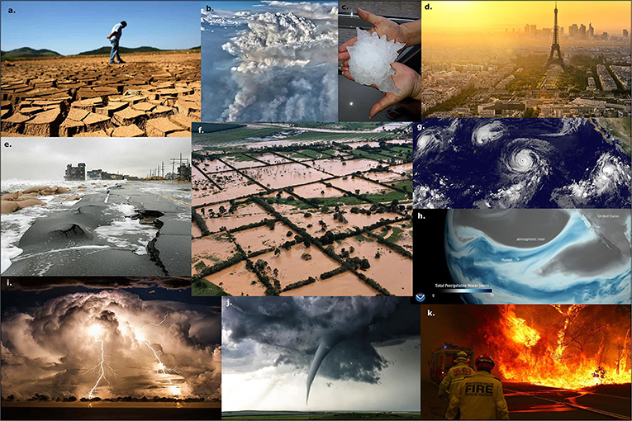
More frequent and severe weather events:
Climate change is leading to more frequent and severe weather events, including heatwaves, droughts, floods, hurricanes, and tornadoes.
These events can have devastating impacts on communities, infrastructure, and the economy.

Slide 16
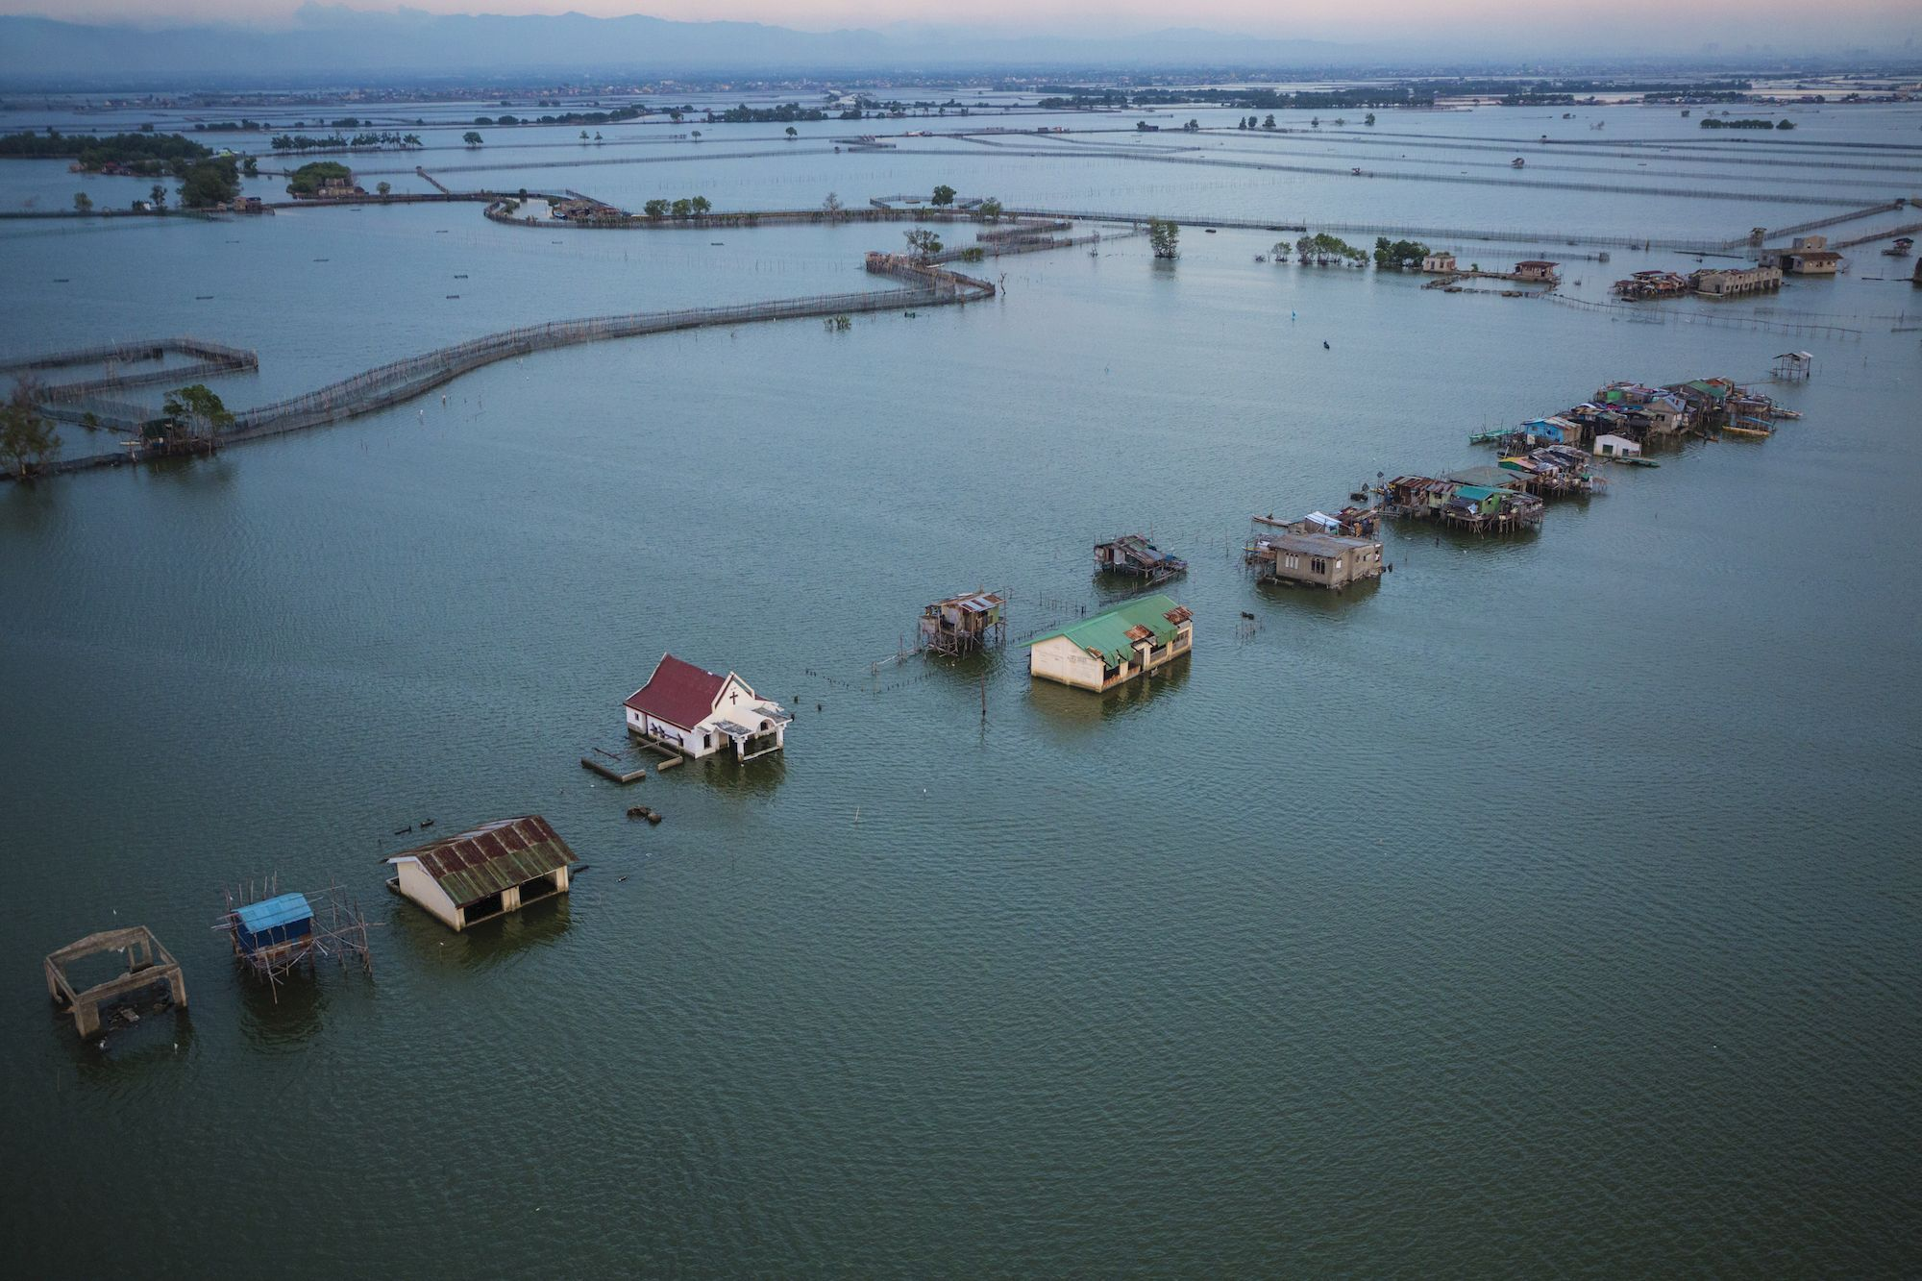
Rising sea levels:
As global temperatures rise, glaciers and ice sheets are melting, causing sea levels to rise.
This can lead to flooding of coastal communities, erosion of beaches and shorelines, and increased damage from storms and storm surges.

Slide 17
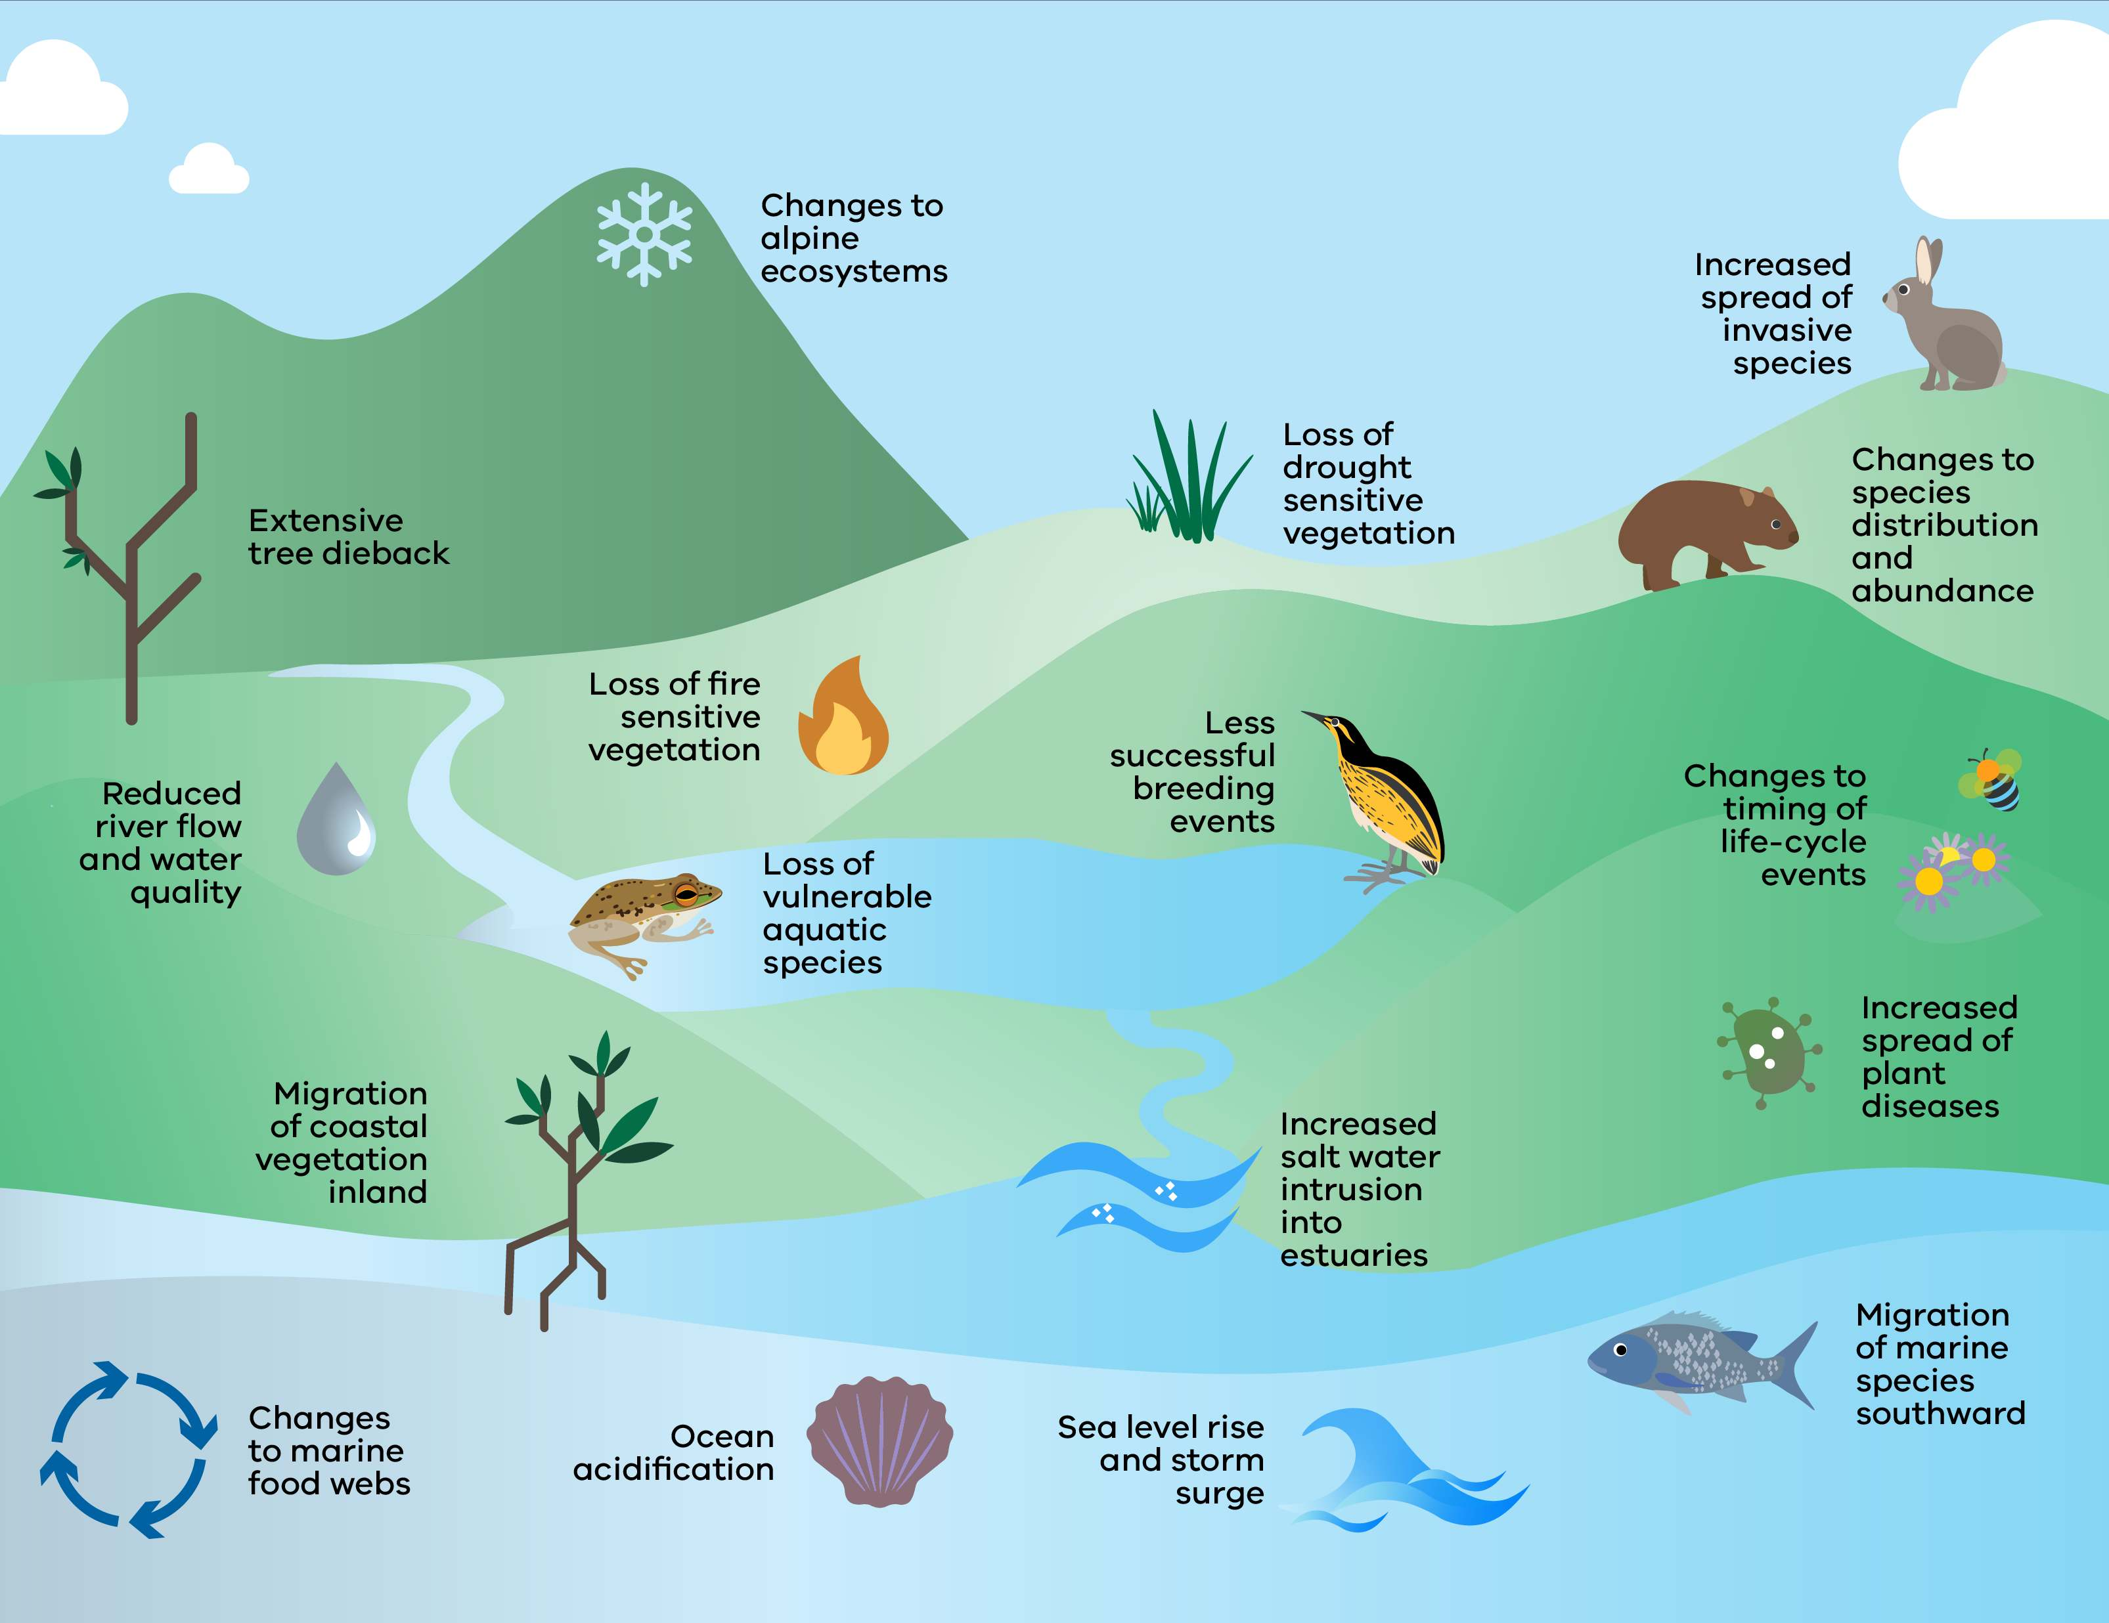
Impacts on ecosystems:
Climate change is having significant impacts on ecosystems, including changes in migration patterns and ranges of plant and animal species, as well as disruptions to ecosystems from extreme weather events and rising sea levels.
These impacts can have far-reaching consequences for biodiversity and the functioning of ecosystems.

Slide 18


Slide 19
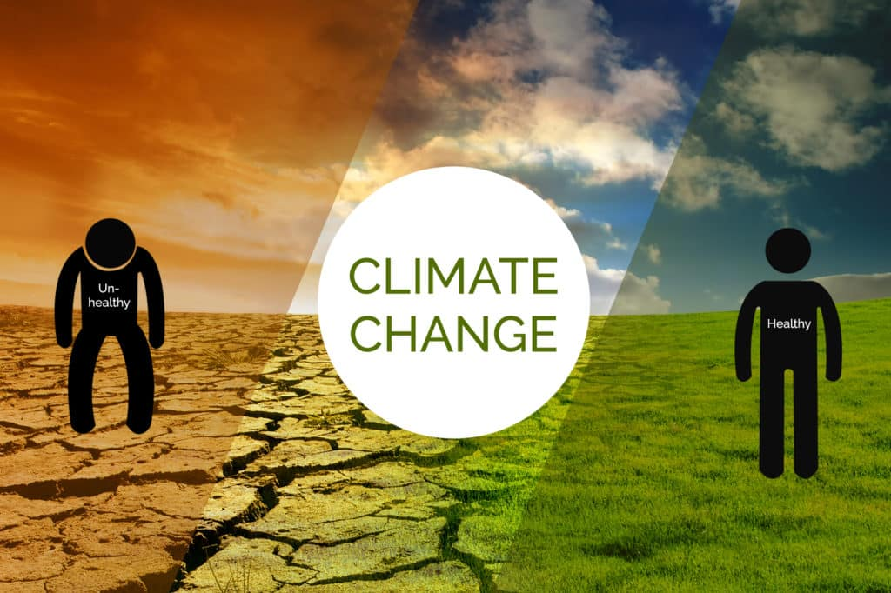
Impacts on human health:
Climate change can have significant impacts on human health, including increased incidence of heat-related illness, respiratory problems from air pollution, and the spread of infectious diseases.
These impacts can disproportionately affect vulnerable populations, such as the elderly, children, and low-income communities.

Slide 20
IV. Impacts on human society
Economic impacts
Social impacts
Political impacts

Slide 21
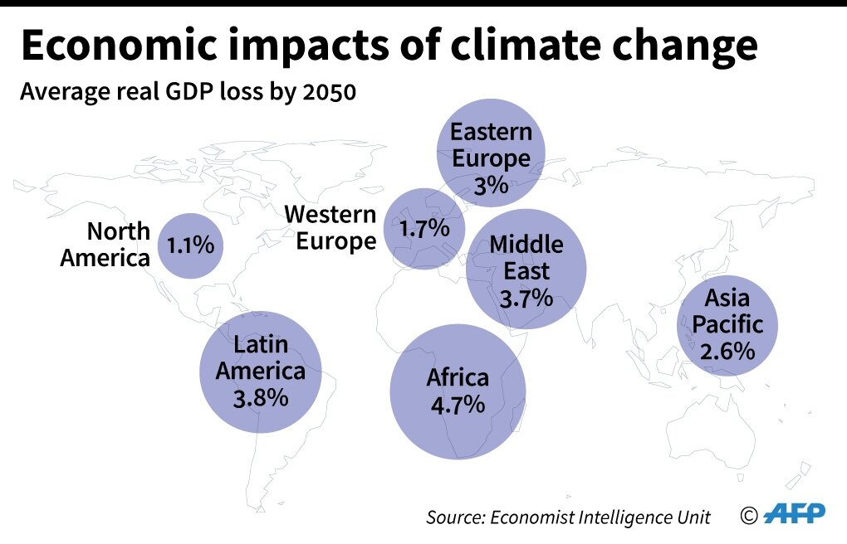
Economic impacts:
Climate change impacts include increased costs from natural disasters, infrastructure damage, and reduced agricultural productivity.
Mitigation and adaptation efforts, such as investing in renewable energy, can also create jobs.

Slide 22
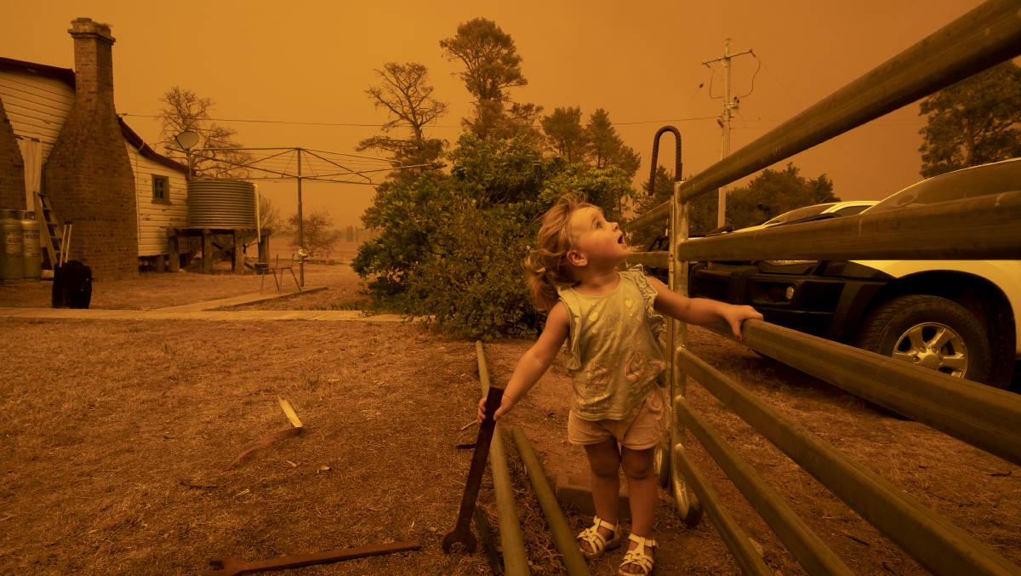
Social impacts:
Climate change disproportionately affects vulnerable populations, such as low-income communities, indigenous peoples, and communities of color.
Impacts include displacement due to sea level rise, loss of livelihoods, and health impacts from air pollution and extreme weather events.

Slide 23
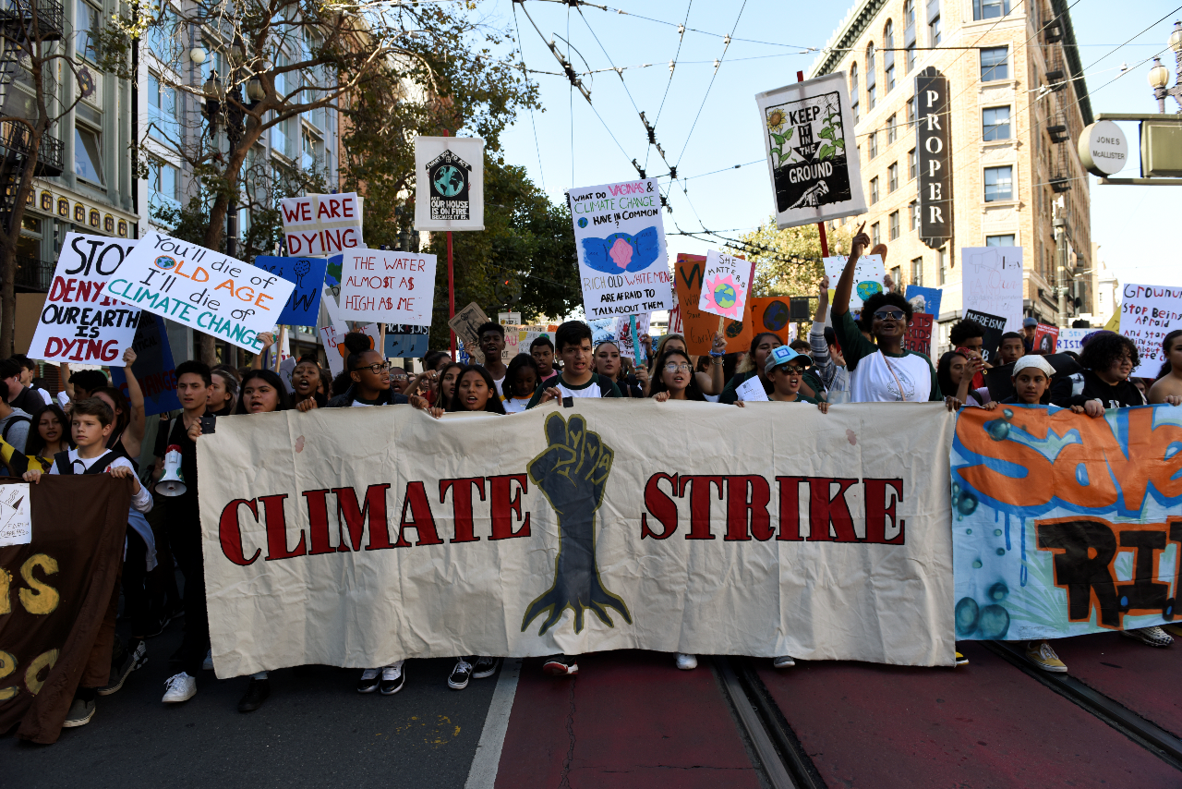
Political impacts:
Climate change is a global issue that requires political action at all levels, leading to significant debates over policies and international cooperation.
Political polarization and ideological differences can also affect the ability to take action.

Slide 24
V. Solutions to address climate change

Slide 25
Mitigation strategies
Reducing greenhouse gas emissions
1
Promoting renewable energy
2
Encouraging sustainable transportation
3

Slide 26
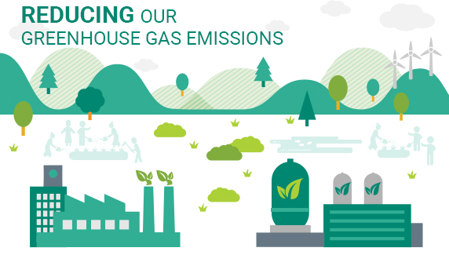
Reducing greenhouse gas emissions:
Reducing greenhouse gas emissions is a key mitigation strategy for climate change.
Policies such as carbon pricing, emissions reduction targets, and energy efficiency measures can achieve this by reducing fossil fuel consumption.

Slide 27
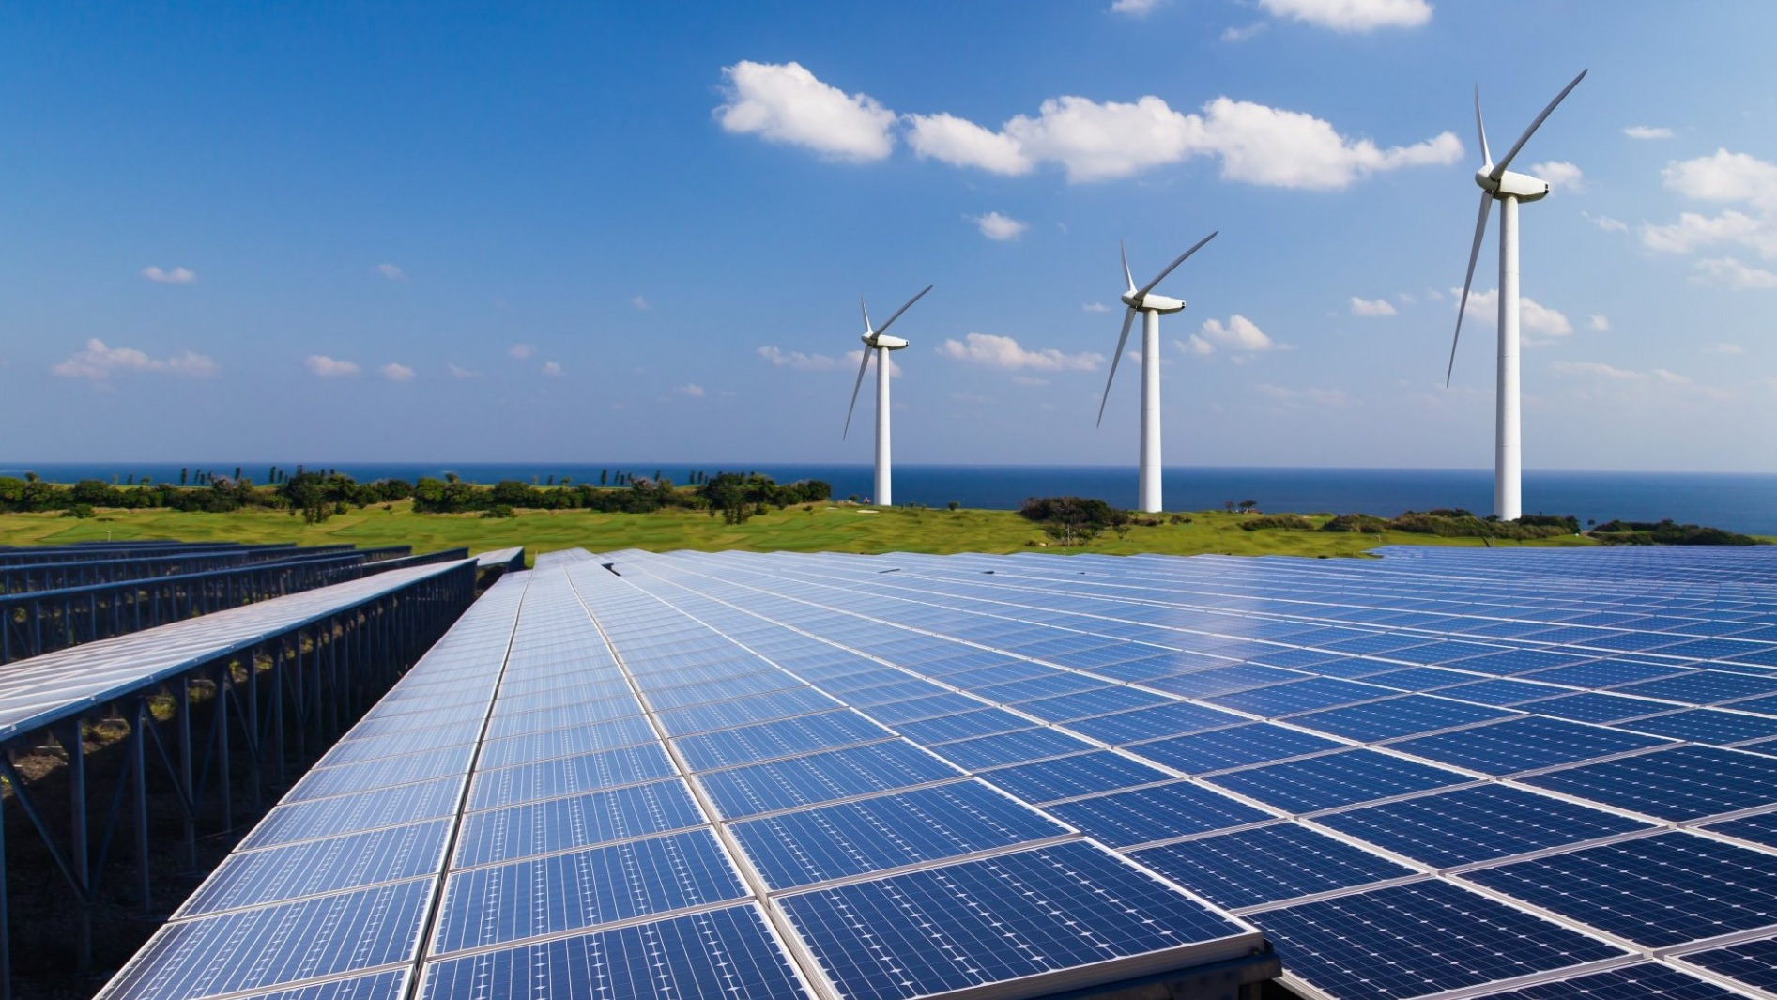
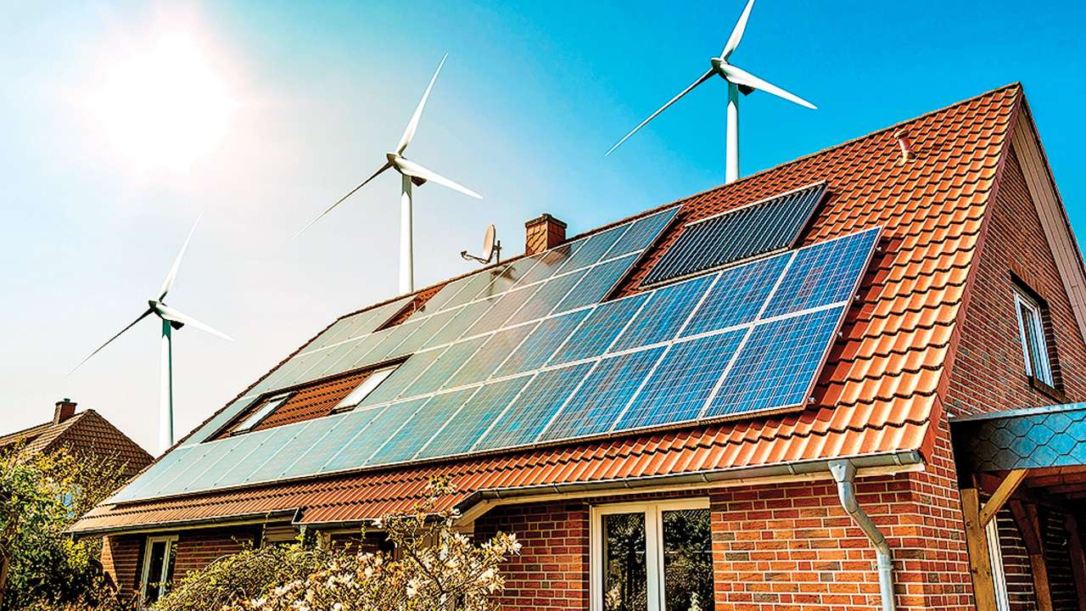
Promoting renewable energy:
Promoting renewable energy sources, like wind, solar, and hydropower, is a crucial mitigation strategy for climate change.
Policies like subsidies, energy efficiency standards, and renewable energy requirements can help achieve this.

Slide 28
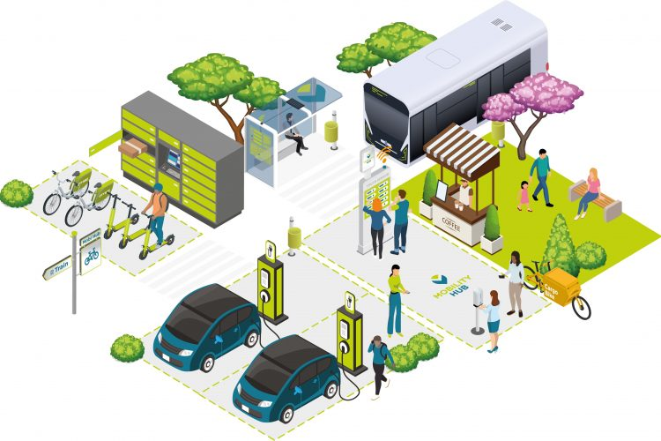
Encouraging sustainable transportation:
Sustainable transportation options are crucial for mitigating climate change as it is a significant source of greenhouse gas emissions.
Strategies include promoting public transportation, investing in bike lanes, pedestrian infrastructure, and incentivizing electric vehicles.

Slide 29
Adaptation strategies
Building infrastructure to protect against rising sea levels
01
Implementing drought-resistant agriculture
02
Developing early warning systems for extreme weather events
03

Slide 30
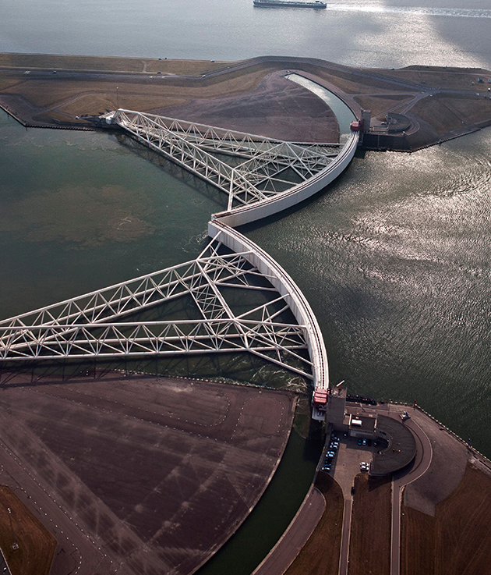
Building infrastructure to protect against rising sea levels:
As sea levels rise due to climate change, coastal communities will be increasingly vulnerable to flooding and storm surges.
One key adaptation strategy is to build infrastructure to protect against these impacts, such as sea walls, levees, and other flood protection measures.

Slide 31
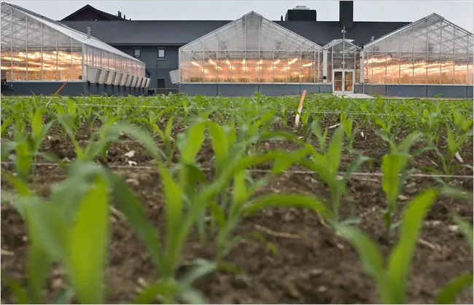
Implementing drought-resistant agriculture:
Adapting to more frequent and severe droughts caused by climate change requires implementing drought-resistant agriculture techniques, such as planting drought-tolerant crops and implementing efficient irrigation systems.

Slide 32

Developing early warning systems for extreme weather events:
Climate change is expected to lead to more frequent and severe extreme weather events, such as hurricanes, floods, and heatwaves.
Developing early warning systems can help communities prepare for these events and reduce the risk of damage and loss of life.

Slide 33
International cooperation and policy

Slide 34
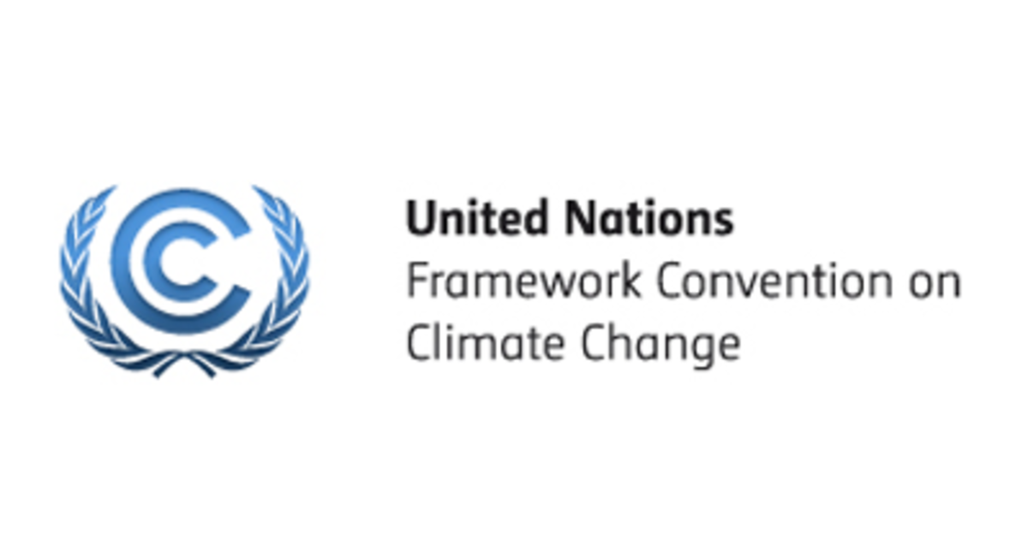
The UNFCCC is the main international treaty for addressing climate change, signed by almost all countries worldwide to stabilize greenhouse gas concentrations and prevent dangerous human interference with the climate system.

Slide 35

COP27 is a vital gathering of world leaders, experts, and activists organized by the UNFCCC to accelerate efforts to reduce emissions and mitigate climate change.
The goal is to limit global warming to below 1.5°C and shape the planet's future.

Slide 36
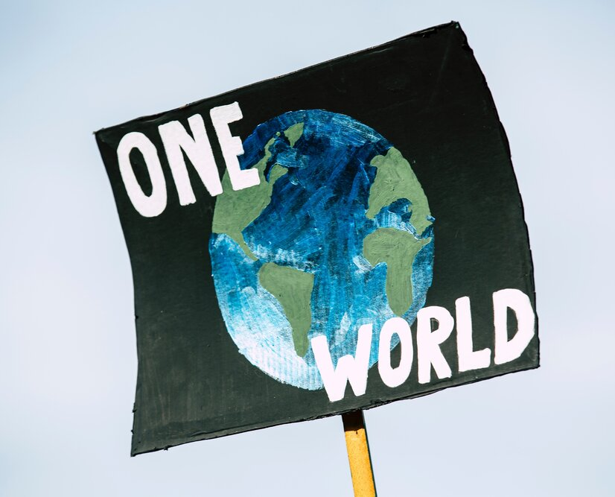
International cooperation is essential for addressing the global nature of the climate change problem.
This includes cooperation on issues such as technology transfer, financing for developing countries, and capacity building to help countries adapt to the impacts of climate change.

Slide 37
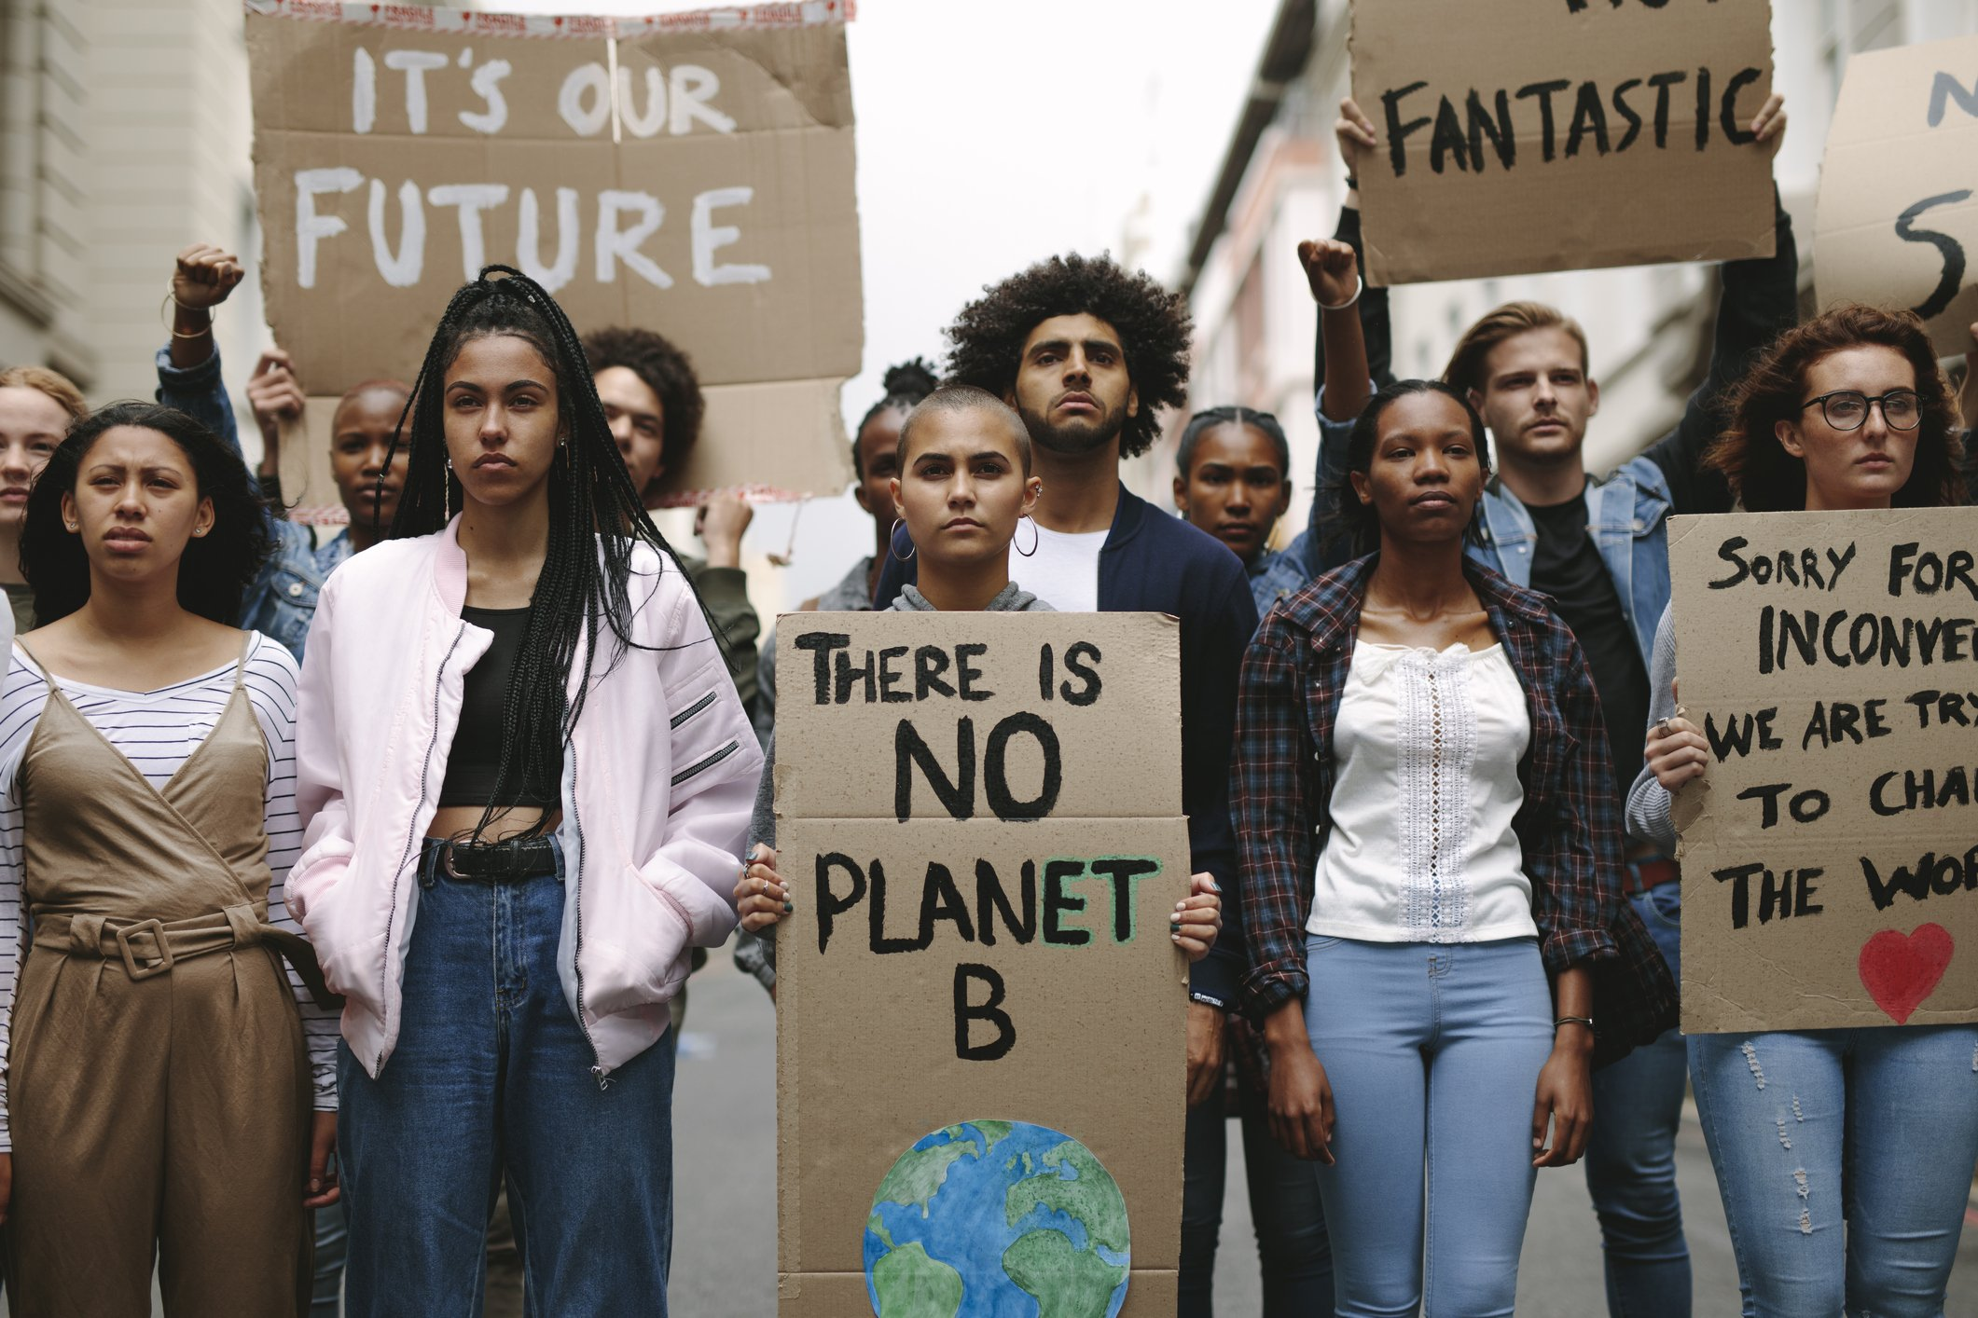
Policymakers at all levels, from local to national and international, have an important role to play in addressing climate change.
This includes implementing policies to reduce greenhouse gas emissions, promoting renewable energy and sustainable transportation, and developing adaptation strategies to protect vulnerable communities.

Slide 38
Conclusion
Summary of key points
Call to action for individuals and governments to take action on climate change

Slide 39
References
https://www.un.org/ar/climatechange/what-is-climate-change
https://climate.nasa.gov/causes/
https://www.epa.gov/climatechange-science/causes-climate-change
https://studentenergy.org/other/greenhouse-gas-emissions/

Slide 40


Slide 41

Shaimaa Hammad Youssef
Shima_hammad@Hotmail.com

